Slide 1



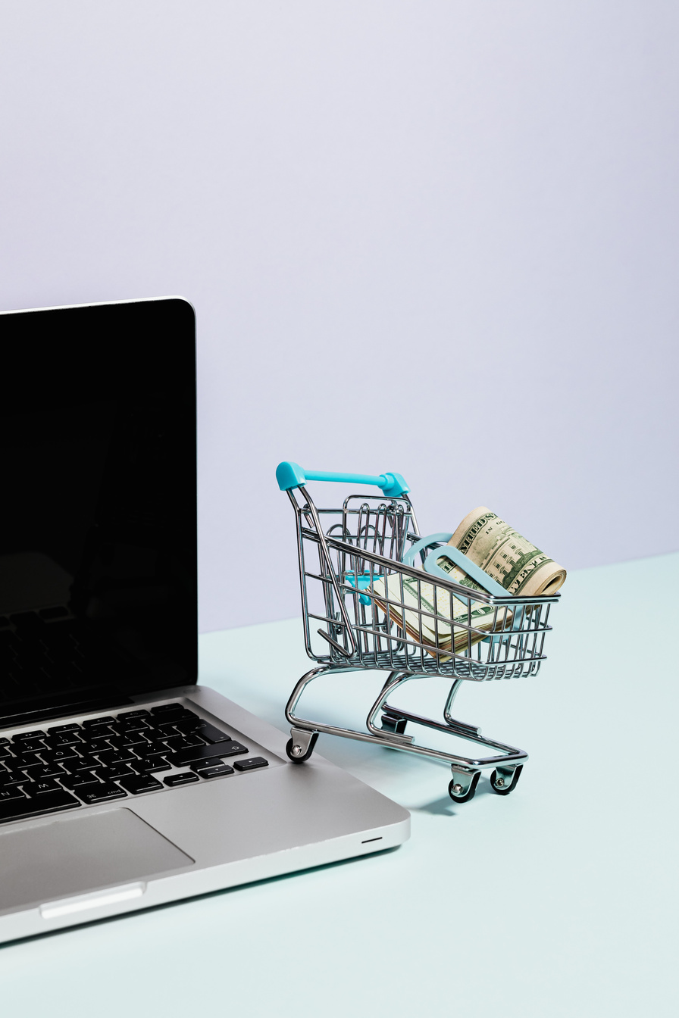


Your one - stop shop
for endless possibilities!
Priyansh Verma
Harsh kaushik
Prashast Saxena
Dhruv jain
Pari
Shikhar Srivastava
MENTORS
Swapnil Bhatnagar & Harsh Keshari

Slide 2
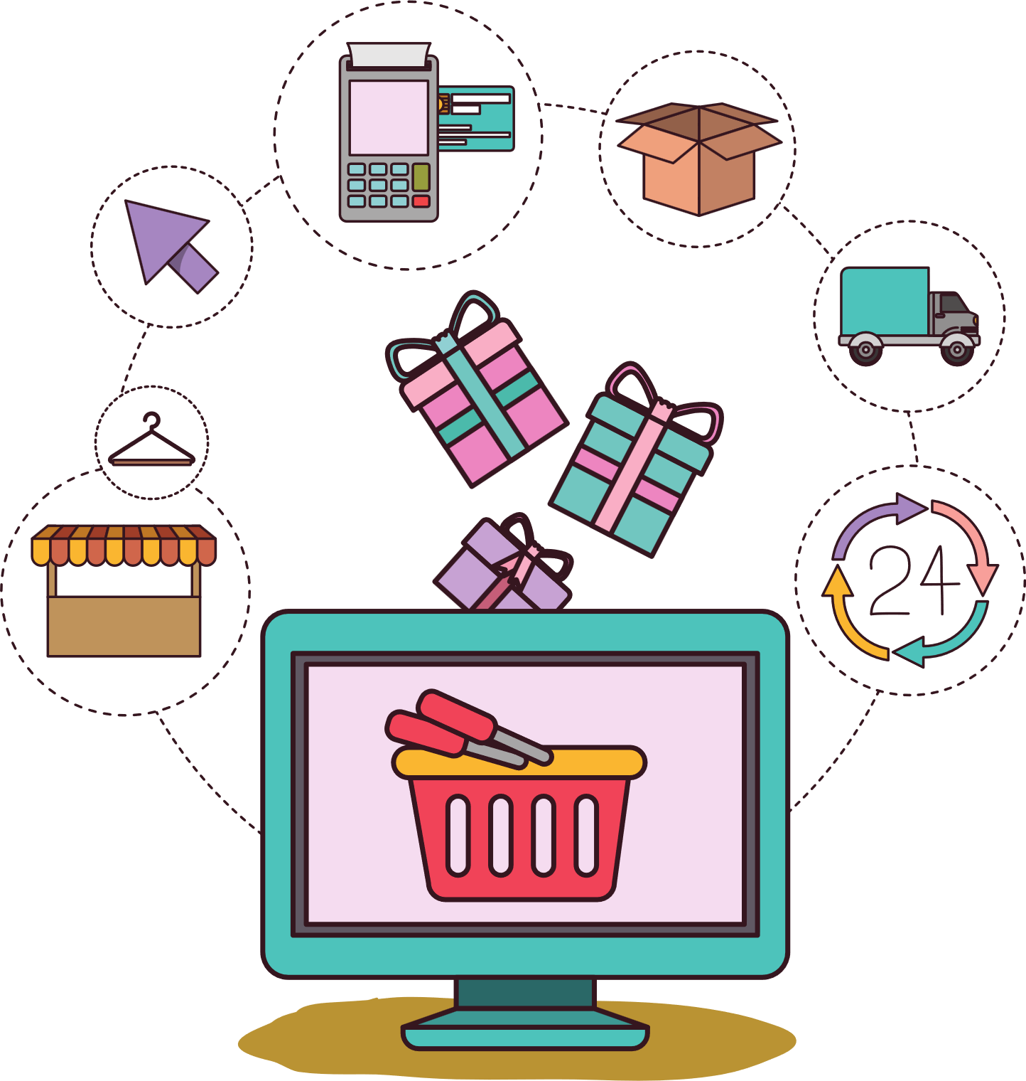

Introduction
E-commerce websites revolutionize the way we conduct business. In this comprehensive presentation, we delve into the advantages of these dynamic platforms. Discover why e-commerce is essential for every business and learn how to effortlessly create an exemplary project. Join us as we explore the world of online commerce and unlock new opportunities for success.
PURPOSE OF E-COMMERCE WEBSITE :
Global Reach: Increased Market Reach: An eCommerce platform allows businesses to reach a global audience without the constraints of physical location, enabling them to expand beyond local markets.
Convenience and Accessibility: 24/7 Accessibility: eCommerce platforms provide users with the convenience of shopping anytime, anywhere, without the limitations of traditional brick-and-mortar store hours.
Customer Experience: Enhanced Customer Experience: Providing a user-friendly and convenient online shopping experience can lead to higher customer satisfaction and loyalty.

Slide 3
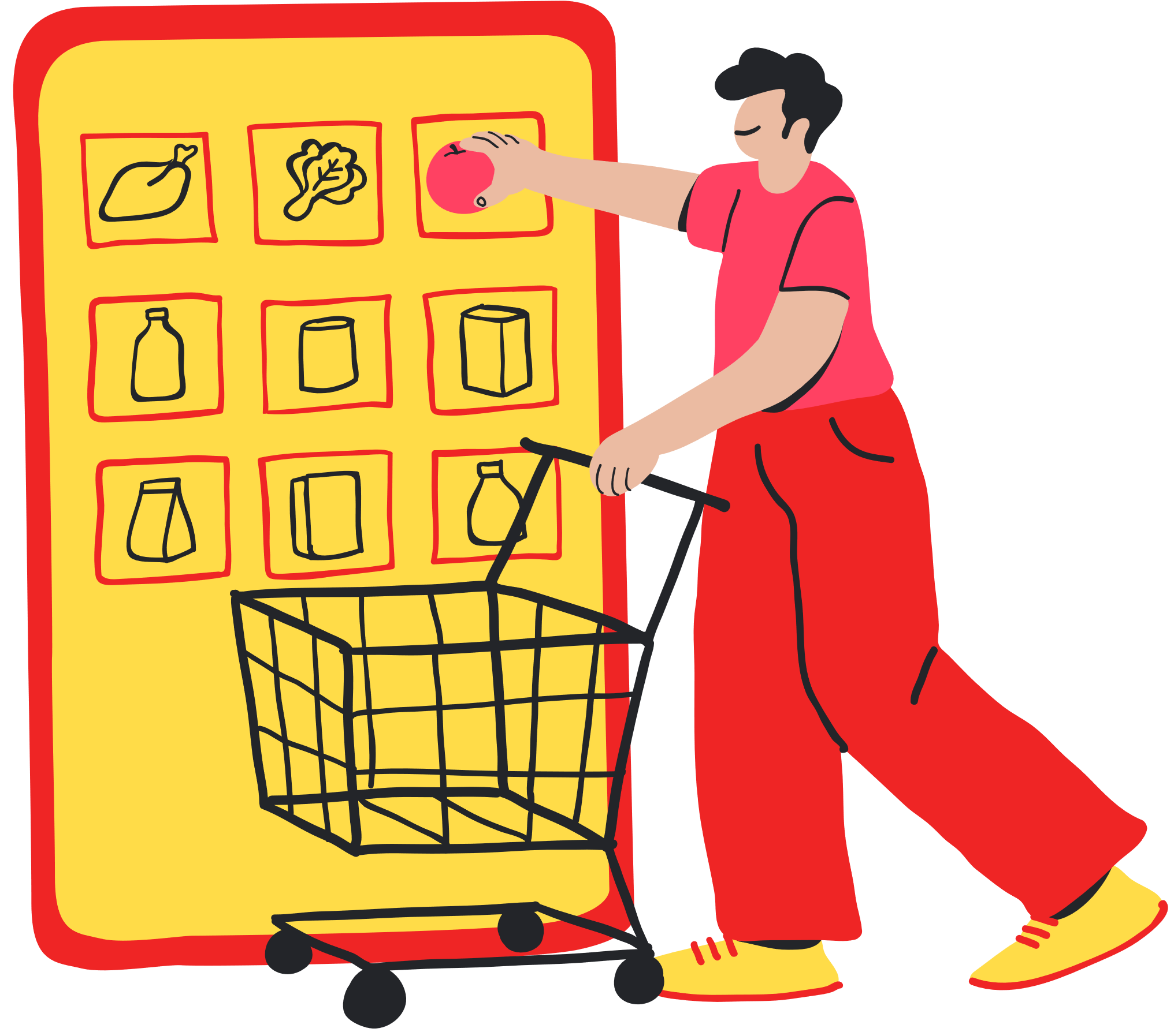
Importance of E - commerce websites
E-commerce websites have become an essential tool for businesses in today's digital era.
Additionally, e-commerce websites offer cost savings in terms of reduced overhead expenses and personalized marketing strategies to target specific customer segments
Overall, they enhance the customer experience by providinga seamless and user-friendly interface for browsing and purchasing products or services

Slide 4





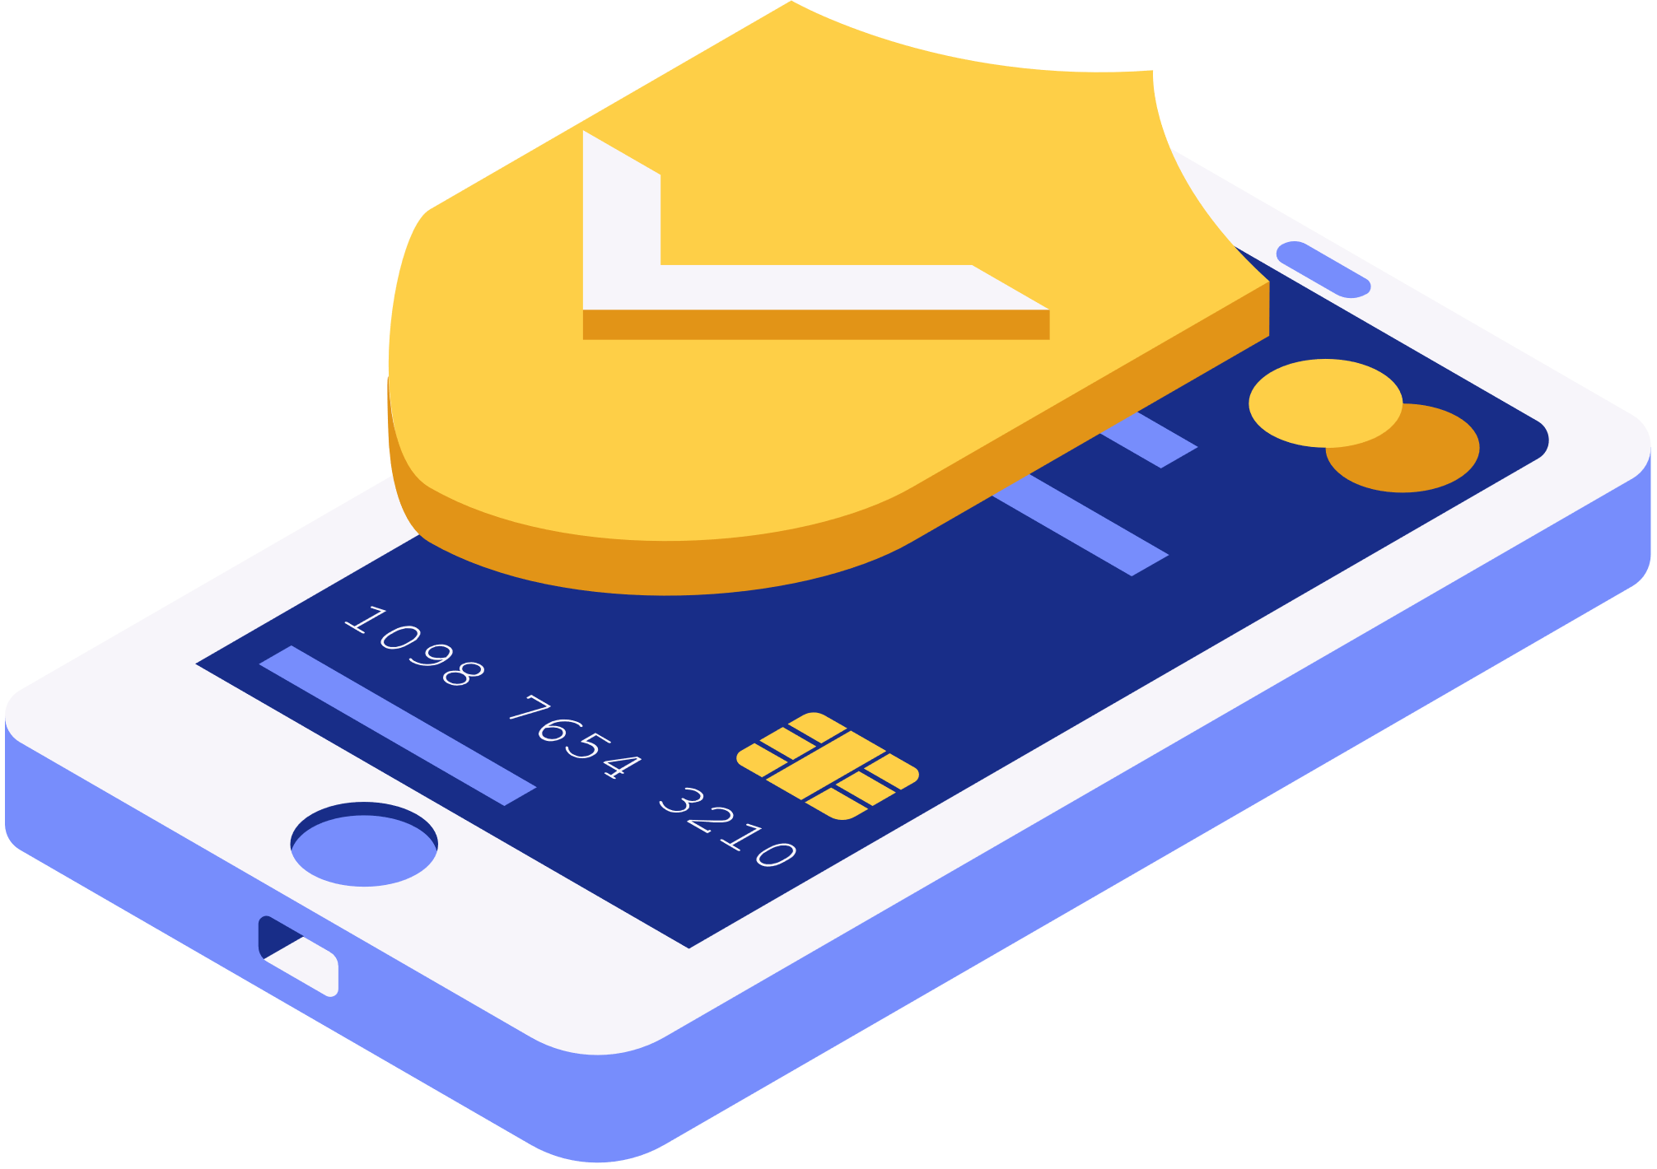
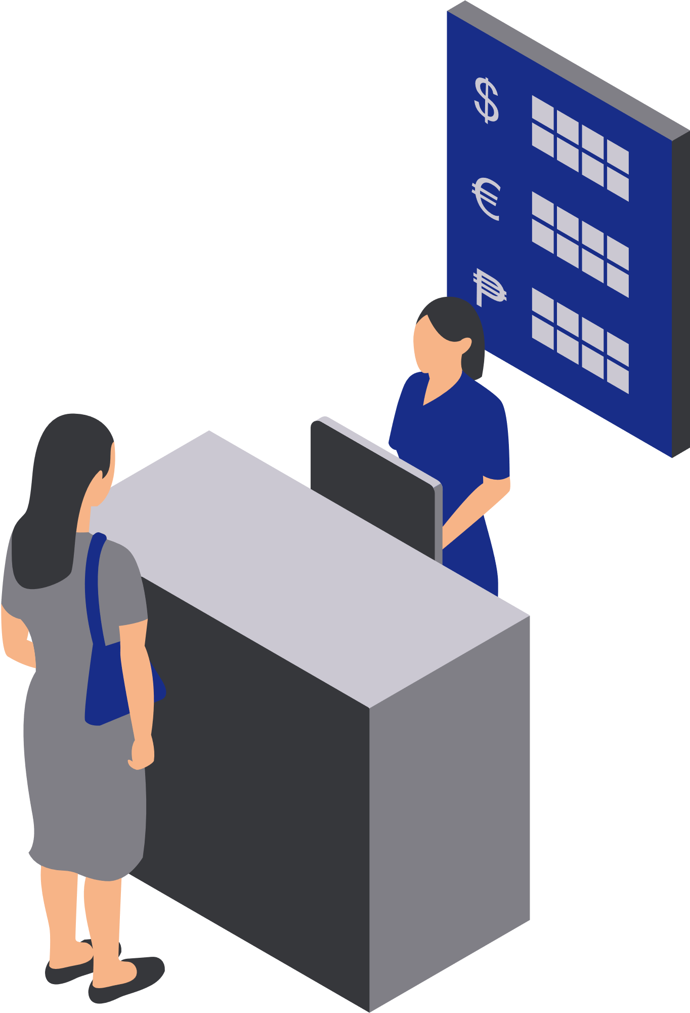

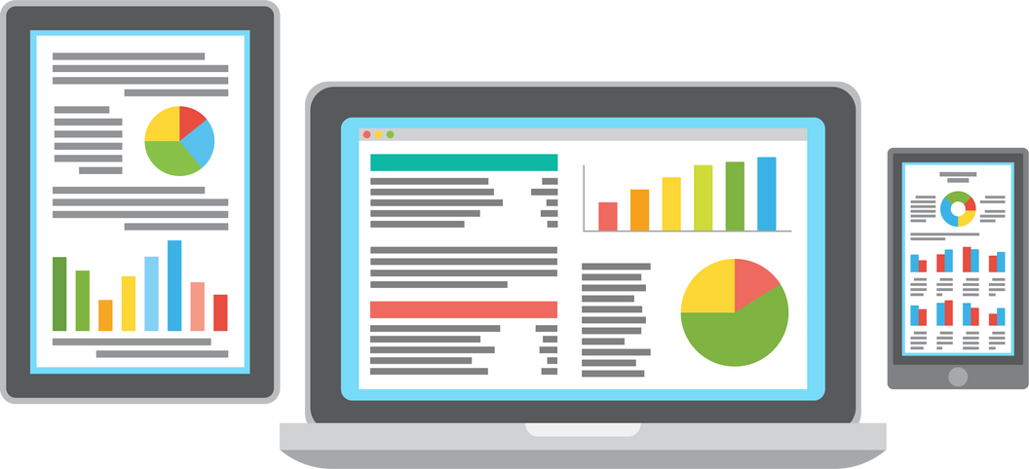
WHY AN E-COMMERCE WEBSITE?
Add items to cart
Real-time Updates
Security

Slide 5


HOW IT GOES

Slide 6

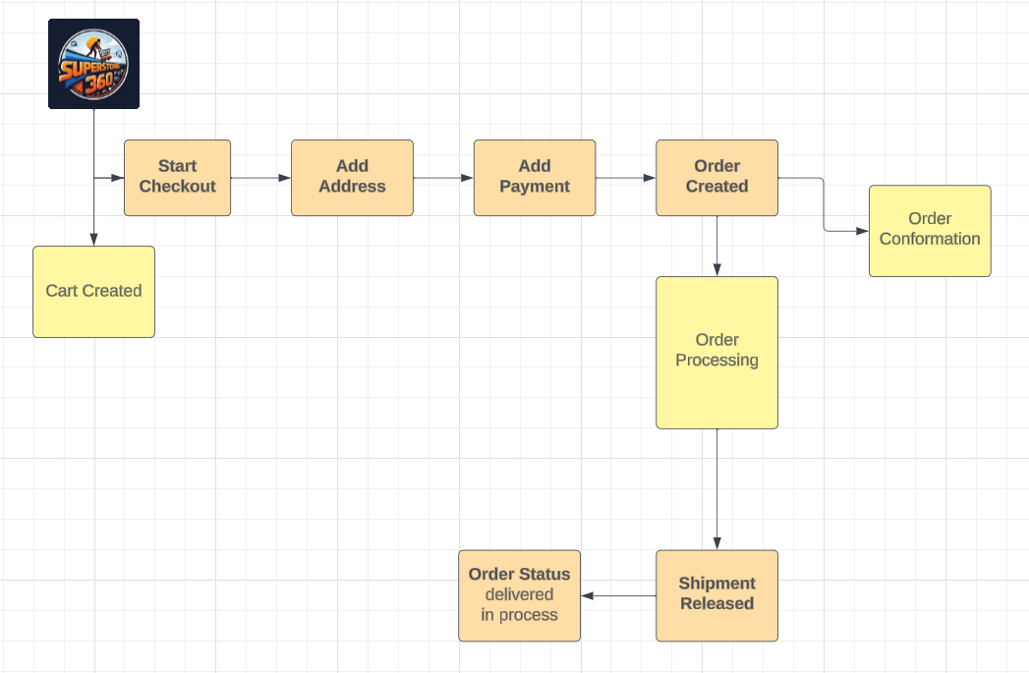
Flow

Slide 7







TECH STACK
The MERN stack is a combination of four key technologies: MongoDB, Express.js, React, and Node.js.
Each component plays a crucial role in the development process
MongoDB is used as the database
Express.js handles server-side logic and routing
React is responsible for the user interface, and Node.js serves as the server-side environment.

Slide 8
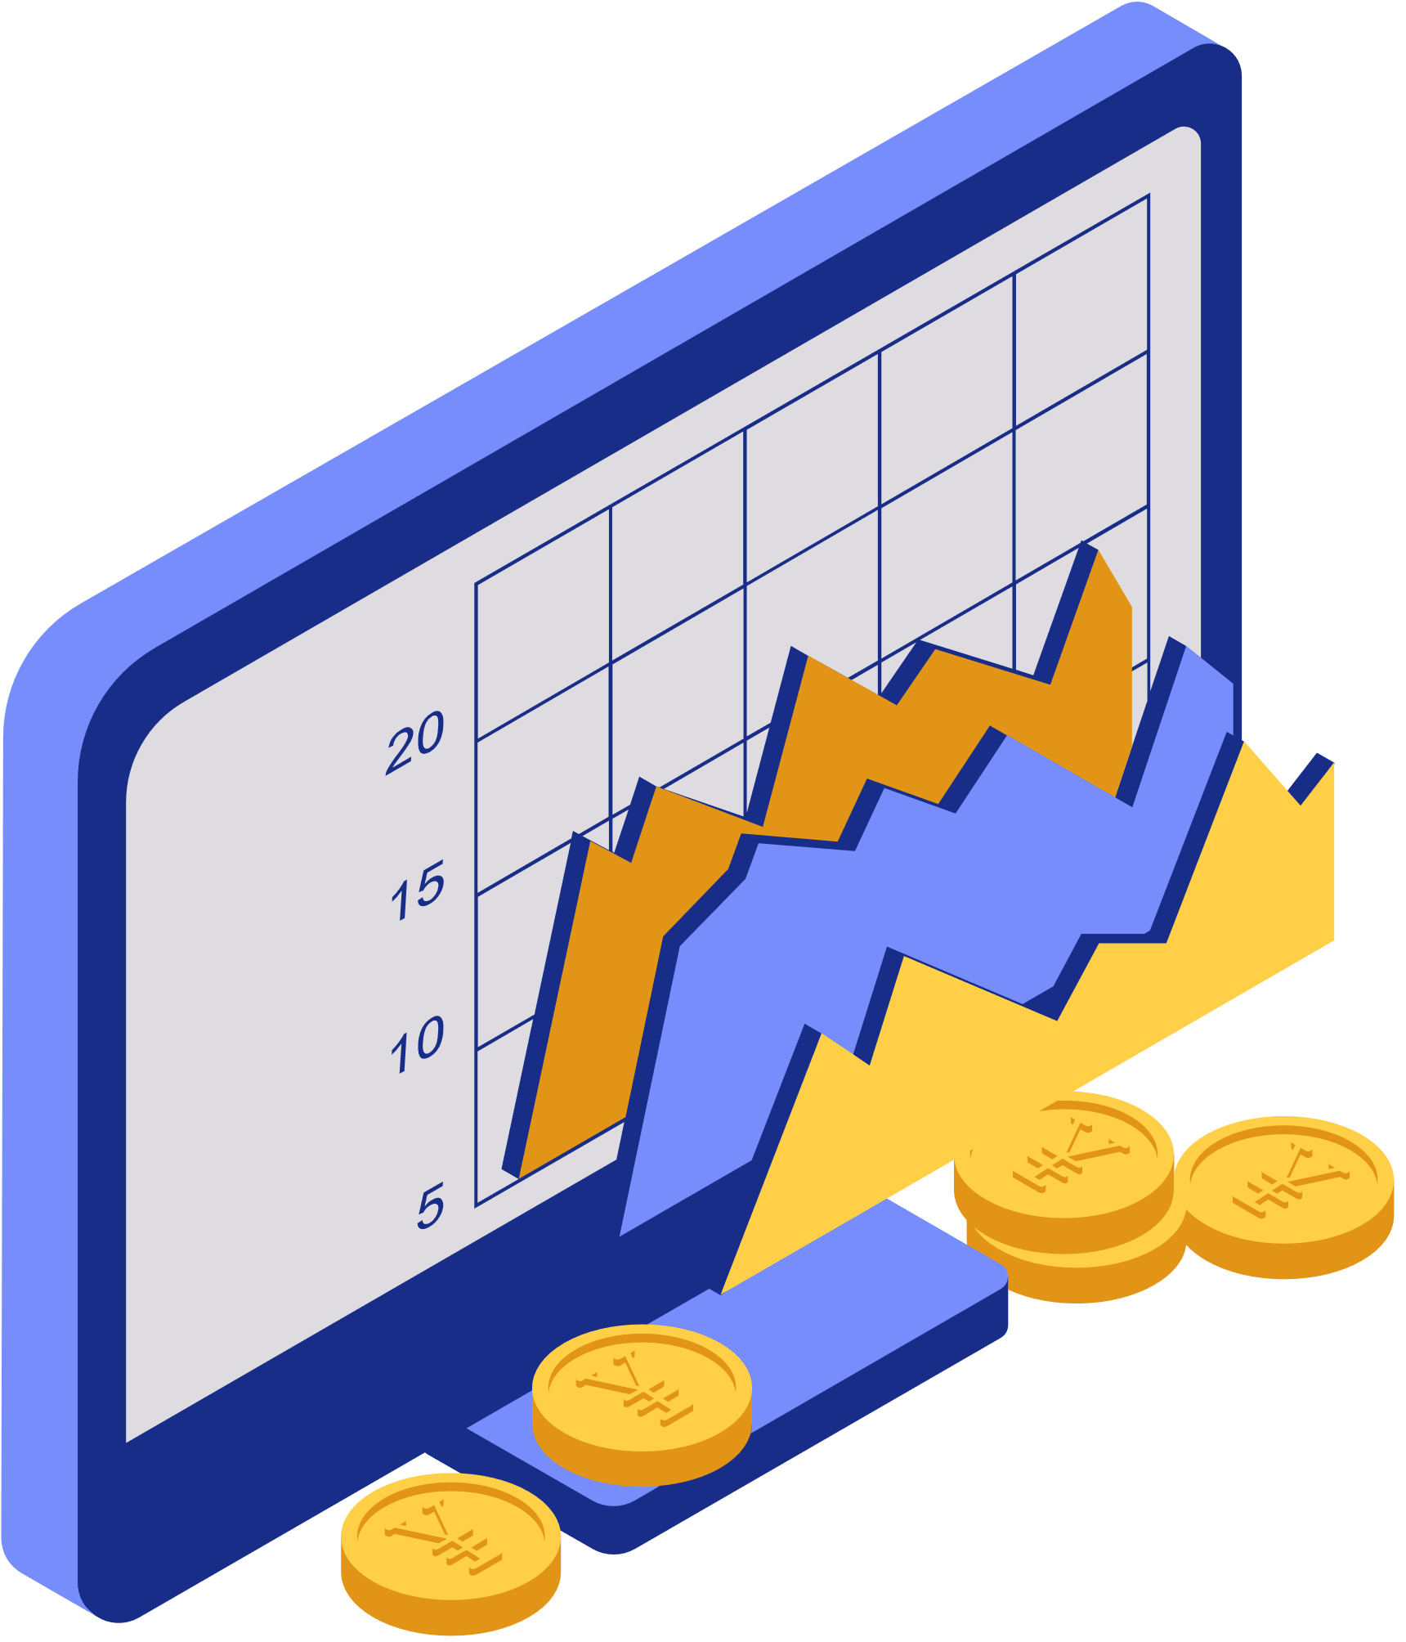
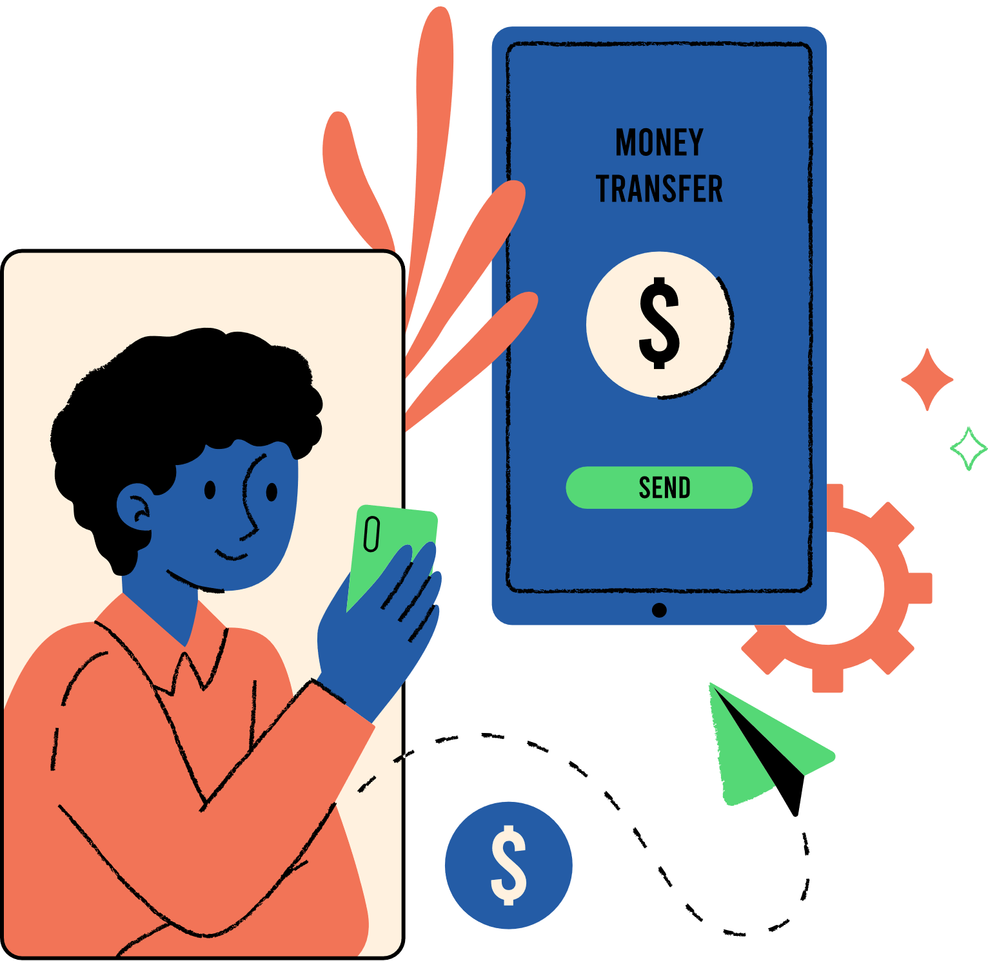




Objectives
Increase Sales
Build Brand Awareness
Mobile Optimization:
Innovation
Social Media Integration
International Expansion

Slide 9


Future scope
As part of our commitment to enhancing user experience, we will launch of our eCommerce mobile app.
Integrating AI and ML into our e-commerce website enhances user experience through-:
1.personalized recommendations
2. dynamic pricing
3. efficient inventory management
4.robust fraud detection.

Slide 10





FunctionalITIES
User Authentication and Authorization:
Order Management
Shopping Cart
Security Features:
Integration with
PAYMENT GATEWAY
USER DASHBOARD

Slide 11



PROBLEMS FACED DURING THE PRODUCTION:
PROBLEM⤵️
Security is a critical concern in eCommerce. Issues like data breaches, payment fraud, and unauthorized access need to be addressed.
SOLUTION⤵️
Implement secure coding practices, use HTTPS, encrypt sensitive data, validate inputs, and adhere to industry standards for payment processing. Regularly update dependencies and conduct security audits.

Slide 12

PROBLEMS FACED DURING THE PRODUCTION:
PROBLEM⤵️
Integrating payment gateways can be complex, and different regions may have specific requirements.
SOLUTION⤵️
Choose widely used payment gateways with good documentation. Consider supporting multiple payment options. Ensure compliance with regional regulations and security standards. Test payment processes thoroughly.

Slide 13

PROJECT TIMELINE

Slide 14
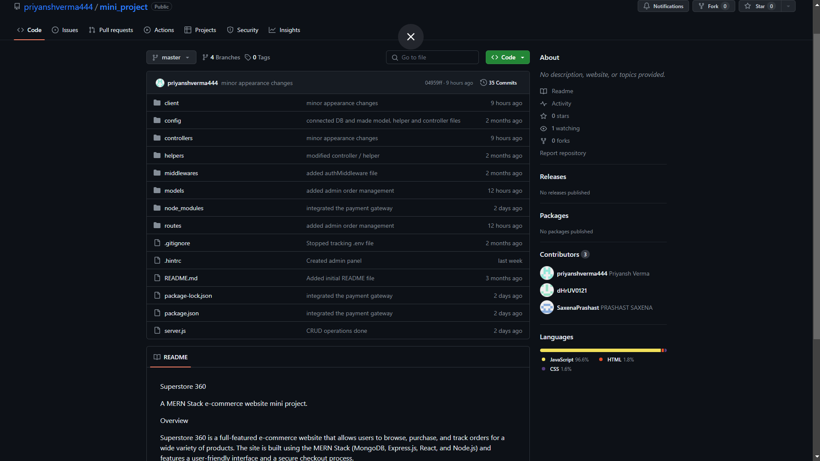

Slide 15
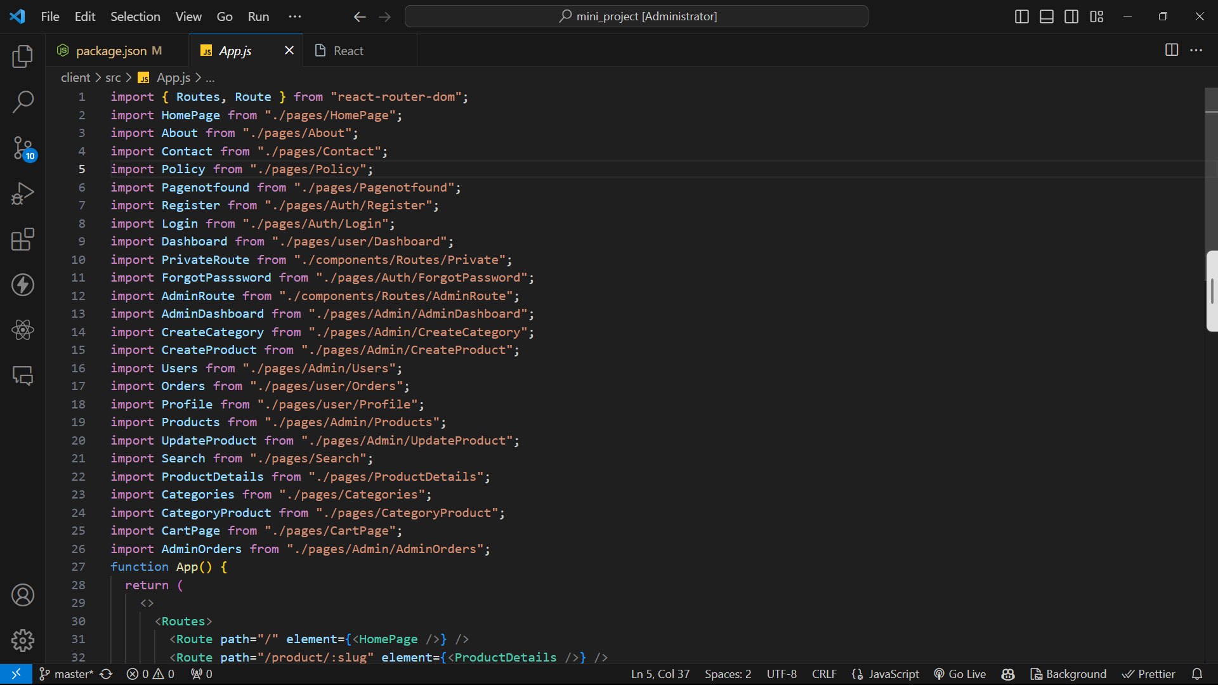

Slide 16


